Slide 1
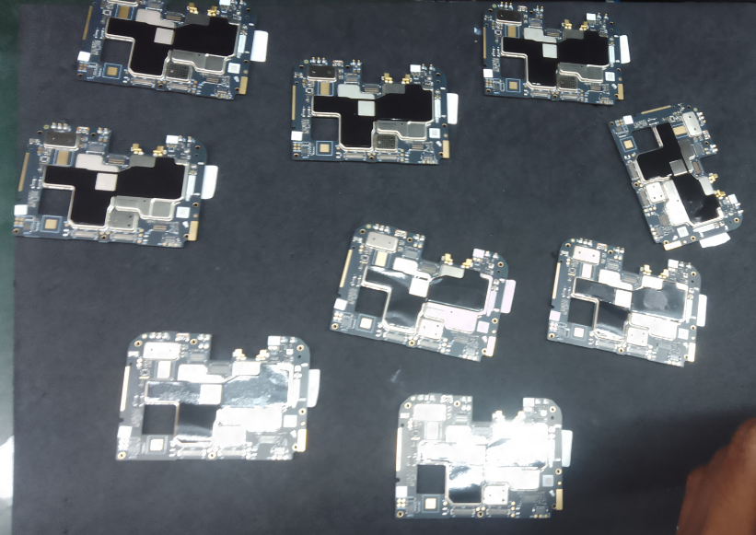
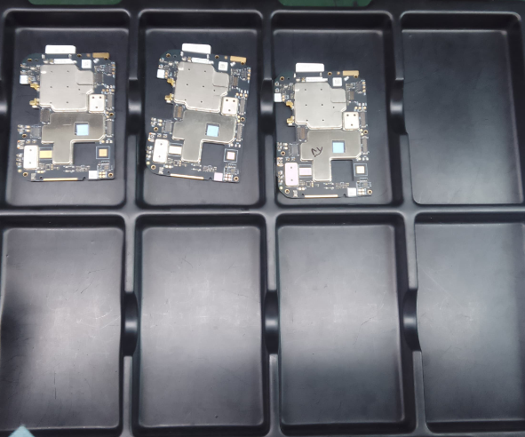
“PCBA Handling Improvement ”
Before Improvement- Handling Status
After Improvement- Handling Status
Prepared by: Aakash

