Slide 1
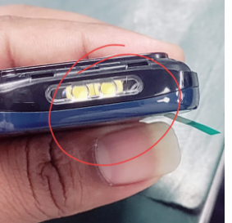
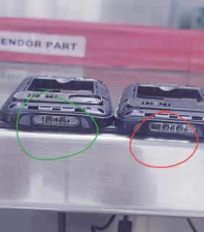
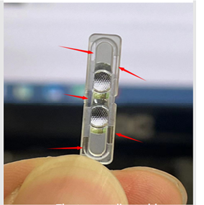
A5_23 Diffuser wire visual appearance at top ends
Before
After
Due to transparent after Assy LED wire visual at top ends
Modified diffuser through shaded at both edges ,prevent from visual appearance

Slide 2
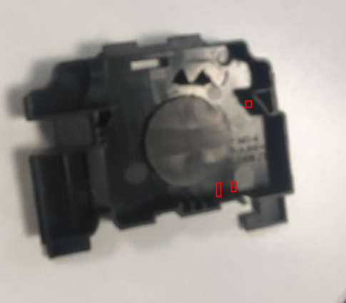
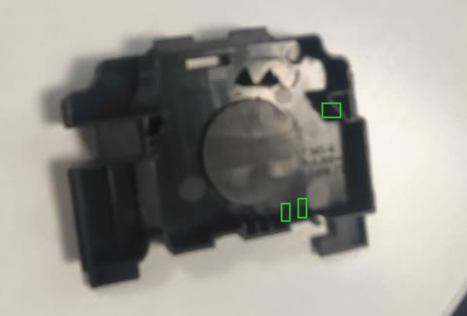
A5_23Speaker rattling sound
Before
After
Speaker bracket rattling sound issue
Modified speaker bracket implement issue resolved permanently

Slide 3
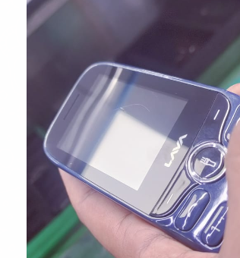
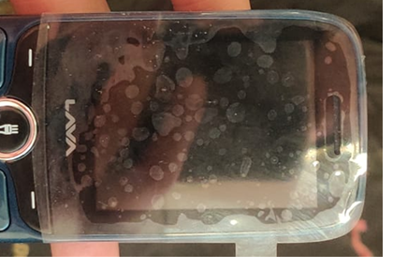
A5_23 Window lens vinyl film implementation
Anuj
Before
After
LCD main lens causes scratch issue
Praposed and developed the main lens vinyl film avoided such issue

Slide 4
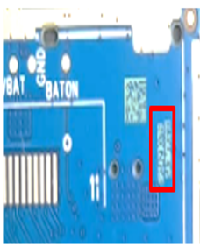
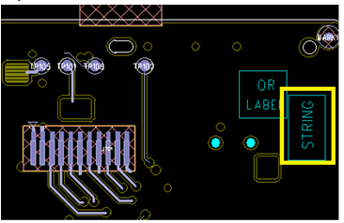
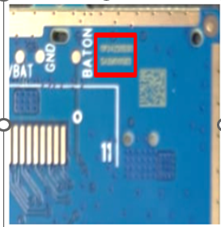
A5_23 laser string location
Anuj
Before
After
Laser string location are near by test point creates issue
String location updated into layout as well PCB avoided issue

Slide 5
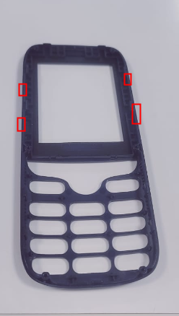
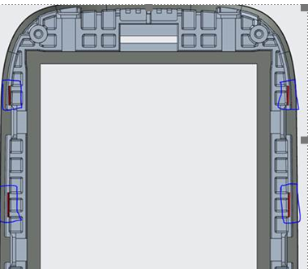
A5_23A-sheel hard fitment issue
Anuj
Before
After
A-shell create hard fitment issue
Provided chamfer at highlighted position ,verified by PD ,SQA no hard issue observed

