Slide 1
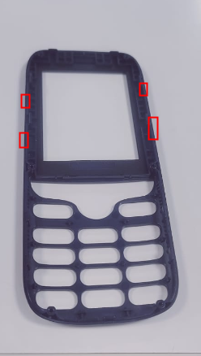
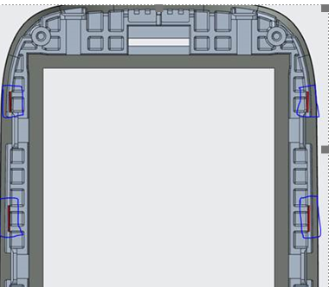
A5_23A-sheel hard fitment issue
Before
After
A-shell create hard fitment issue
Provided chamfer at highlighted position ,verified by PD ,SQA no hard issue observed

Slide 2
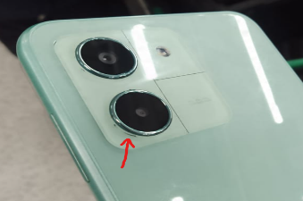
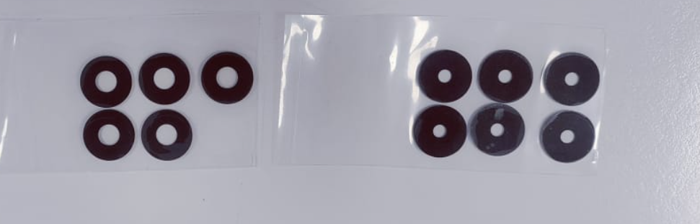
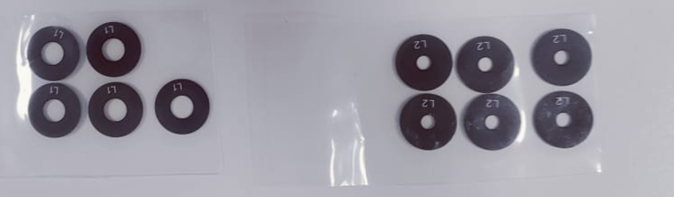
Yuva4 _Camera lens mixing issue while assy
Before
After
No-identification to fix while assy ,Chance of mix
Identification updated ,no mixing while assy

Slide 3

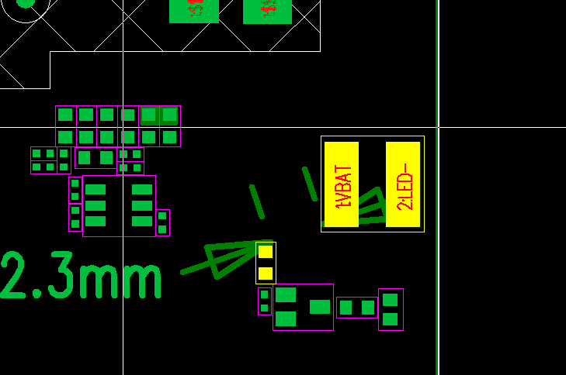
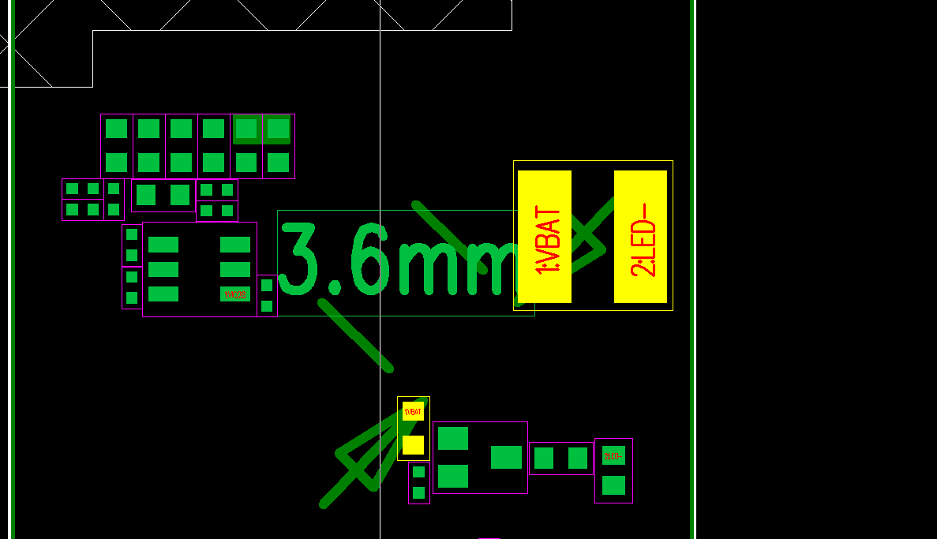
Change 1- Shifting of Flashlight LED’s Components_Hero 1800
IL18O7-Old-(Distance is 2.3 mm)
IL1841-New-(Distance is 3.6mm)

Slide 4
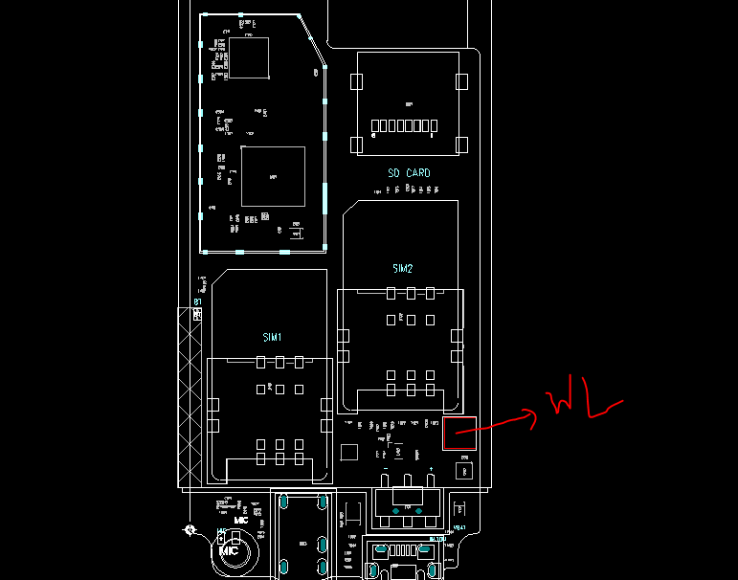
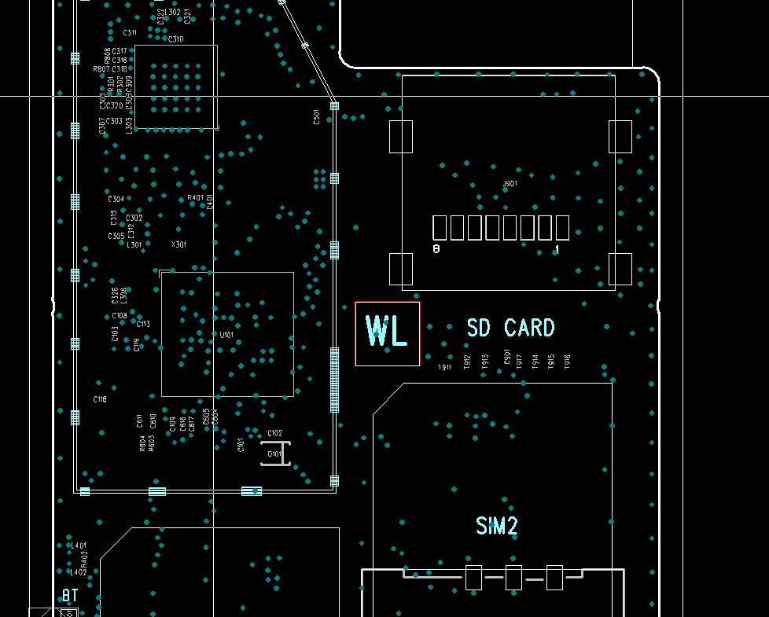
Pawan
Change 3- Change in Position of Water label in Hero 1800
IL18O7-Old
IL1841-New

